Slide 1
Unit 14 Decision Tree
Machine Learning

Slide 2
Decision Tree Classification Algorithm
Decision Tree is a Supervised learning technique that can be used for both classification and Regression problems, but mostly it is preferred for solving Classification problems.
It is a tree-structured classifier, where internal nodes represent the features of a dataset, branches represent the decision rules and each leaf node represents the outcome.

Slide 3
Decision Tree Classification Algorithm
In a Decision tree, there are two nodes, which are the Decision Node and Leaf Node.
Decision nodes are used to make any decision and have multiple branches, whereas Leaf nodes are the output of those decisions and do not contain any further branches.
The decisions or the test are performed on the basis of features of the given dataset.

Slide 4
Decision Tree Classification Algorithm
It is a graphical representation for getting all the possible solutions to a problem/decision based on given conditions.
It is called a decision tree because, similar to a tree, it starts with the root node, which expands on further branches and constructs a tree-like structure.
In order to build a tree, we use the CART algorithm, which stands for Classification and Regression Tree algorithm.

Slide 5
Decision Tree Classification Algorithm
A decision tree simply asks a question, and based on the answer (Yes/No), it further split the tree into subtrees.
Note: A decision tree can contain categorical data (YES/NO) as well as numeric data.

Slide 6
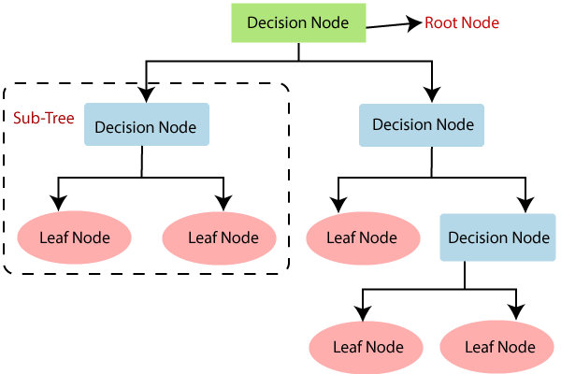
Decision Tree Classification Algorithm
Below diagram explains the general structure of a decision tree:

Slide 7
Why use Decision Trees?
There are various algorithms in Machine learning
So choosing the best algorithm for the given dataset and problem is the main point to remember while creating a machine learning model.

Slide 8
Why use Decision Trees?
Below are the two reasons for using the Decision tree:
  Decision Trees usually mimic human thinking ability while making a decision, so it is easy to understand.
  The logic behind the decision tree can be easily understood because it shows a tree-like structure.

Slide 9
Decision Tree Terminologies
Root Node: is from where the decision tree starts.
It represents the entire dataset, which further gets divided into two or more homogeneous sets.
Leaf Node: are the final output node, and the tree cannot be segregated further after getting a leaf node.

Slide 10
Decision Tree Terminologies
Splitting: is the process of dividing the decision node/root node into sub-nodes according to the given conditions.
Branch/Sub Tree: A tree formed by splitting the tree.
Pruning: Pruning is the process of removing the unwanted branches from the tree.
Parent/Child node: The root node of the tree is called the parent node, and other nodes are called the child nodes.

Slide 11
How does the Decision Tree algorithm Work?
In a decision tree, for predicting the class of the given dataset, the algorithm starts from the root node of the tree.
This algorithm compares the values of root attribute with the record (real dataset) attribute and, based on the comparison, follows the branch and jumps to the next node.

Slide 12
How does the Decision Tree algorithm Work?
For the next node, the algorithm again compares the attribute value with the other sub-nodes and move further.
It continues the process until it reaches the leaf node of the tree.
The complete process can be better understood using the below algorithm:

Slide 13
How does the Decision Tree algorithm Work?
The complete process can be better understood using the below algorithm:
  Step-1: Begin the tree with the root node, says S, which contains the complete dataset.
  Step-2: Find the best attribute in the dataset using Attribute Selection Measure (ASM).
  Step-3: Divide the S into subsets that contains possible values for the best attributes.

Slide 14
How does the Decision Tree algorithm Work?
  Step-4: Generate the decision tree node, which contains the best attribute.
  Step-5: Recursively make new decision trees using the subsets of the dataset created in step -3.
  Continue this process until a stage is reached where you cannot further classify the nodes and called the final node as a leaf node.

Slide 15
How does the Decision Tree algorithm Work?
Example: Suppose there is a candidate who has a job offer and wants to decide whether he should accept the offer or Not.
So, to solve this problem, the decision tree starts with the root node (Salary attribute by ASM).
The root node splits further into the next decision node (distance from the office) and one leaf node based on the corresponding labels.

Slide 16
How does the Decision Tree algorithm Work?
The next decision node further gets split into one decision node (Cab facility) and one leaf node.
Finally, the decision node splits into two leaf nodes (Accepted offers and Declined offer).

Slide 17
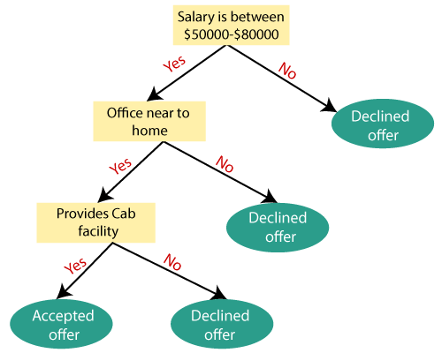
How does the Decision Tree algorithm Work?
Consider the below diagram:

Slide 18
Attribute Selection Measures
While implementing a Decision tree, the main issue arises that how to select the best attribute for the root node and for sub-nodes.
So, to solve such problems there is a technique which is called as Attribute selection measure or ASM.

Slide 19
Attribute Selection Measures
By this measurement, we can easily select the best attribute for the nodes of the tree.
There are two popular techniques for ASM, which are:
  Information Gain
  Gini Index

Slide 20
Information Gain:
It is the measurement of changes in entropy after the segmentation of a dataset based on an attribute.
It calculates how much information a feature provides us about a class.

Slide 21
Information Gain:
According to the value of information gain, we split the node and build the decision tree.
A decision tree algorithm always tries to maximize the value of information gain, and a node/attribute having the highest information gain is split first.

Slide 22
Information Gain:
It can be calculated using the below formula:
  Information Gain= Entropy(S)- [(Weighted Avg) *Entropy(each feature)
  Entropy is a metric to measure the impurity in a given attribute.
  It specifies randomness in data.

Slide 23
Information Gain:
Entropy can be calculated as:
  Entropy(s)= -P(yes)log2 P(yes)- P(no) log2 P(no)
    S= Total number of samples
    P(yes)= probability of yes
    P(no)= probability of no

Slide 24
Gini Index:
Gini index is a measure of impurity or purity used while creating a decision tree in the CART(Classification and Regression Tree) algorithm.
An attribute with the low Gini index should be preferred as compared to the high Gini index.
It only creates binary splits, and the CART algorithm uses the Gini index to create binary splits.

Slide 25
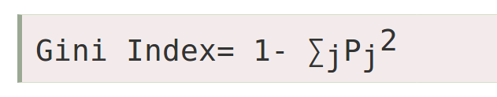
Gini Index:
Gini index can be calculated using the below formula:

Slide 26
Pruning: Getting an Optimal Decision tree
Pruning is a process of deleting the unnecessary nodes from a tree in order to get the optimal decision tree.
A too-large tree increases the risk of overfitting, and a small tree may not capture all the important features of the dataset.
Therefore, a technique that decreases the size of the learning tree without reducing accuracy is known as Pruning.

Slide 27
Pruning: Getting an Optimal Decision tree
There are mainly two types of tree pruning technology used:
  Cost Complexity Pruning
  Reduced Error Pruning

Slide 28
Advantages of the Decision Tree
It is simple to understand as it follows the same process which a human follow while making any decision in real-life.
It can be very useful for solving decision-related problems.
It helps to think about all the possible outcomes for a problem.
There is less requirement of data cleaning compared to other algorithms.

Slide 29
Disadvantages of the Decision Tree
The decision tree contains lots of layers, which makes it complex.
It may have an overfitting issue, which can be resolved using the Random Forest algorithm.
For more class labels, the computational complexity of the decision tree may increase.

Slide 30
Lab
https://www.javatpoint.com/machine-learning-decision-tree-classification-algorithm

